Slide 1
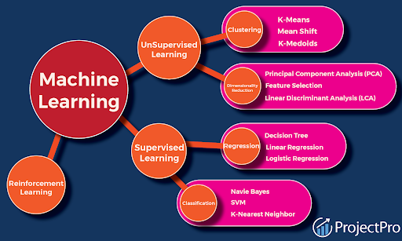

Scalable Serverless Website Deployment Using AWS
Presented by T15 Group
Anshika Tripathi
Dheeraj Kriplani
Prerit Jain
Aditya Narayan Gupta
Mansi Saxena
Mentored by
Rick Chatterjee
Garvit Dohere

Slide 2

OBJECTIVE
To develop a serverless attendance management system using dynamic QR codes and OTPs for secure and convenient attendance marking.
To create predictive models that forecast placement and admission trends based on historical data.
To deploy the application on AWS Lambda, ensuring scalability, cost savings, and efficient resource usage.

Slide 3

INTRODUCTION
Educational institutions require efficient systems to manage attendance and predict placement outcomes. The motivation for this project stems from the need for a scalable, cost-effective solution that can automate attendance processes and provide predictive insights. AWS Lambda, a serverless compute service, was chosen to eliminate the need for traditional server infrastructure and provide scalability on demand, reducing operational costs and enhancing system reliability.

Slide 4





STATUS OF PROJECT
User Interfaces are completed with all working features
Project is deployed using AWS.
QR Scanner and QR Generator have passed the tests.
Predictors are able to predict the required values for upcoming year.

Slide 5
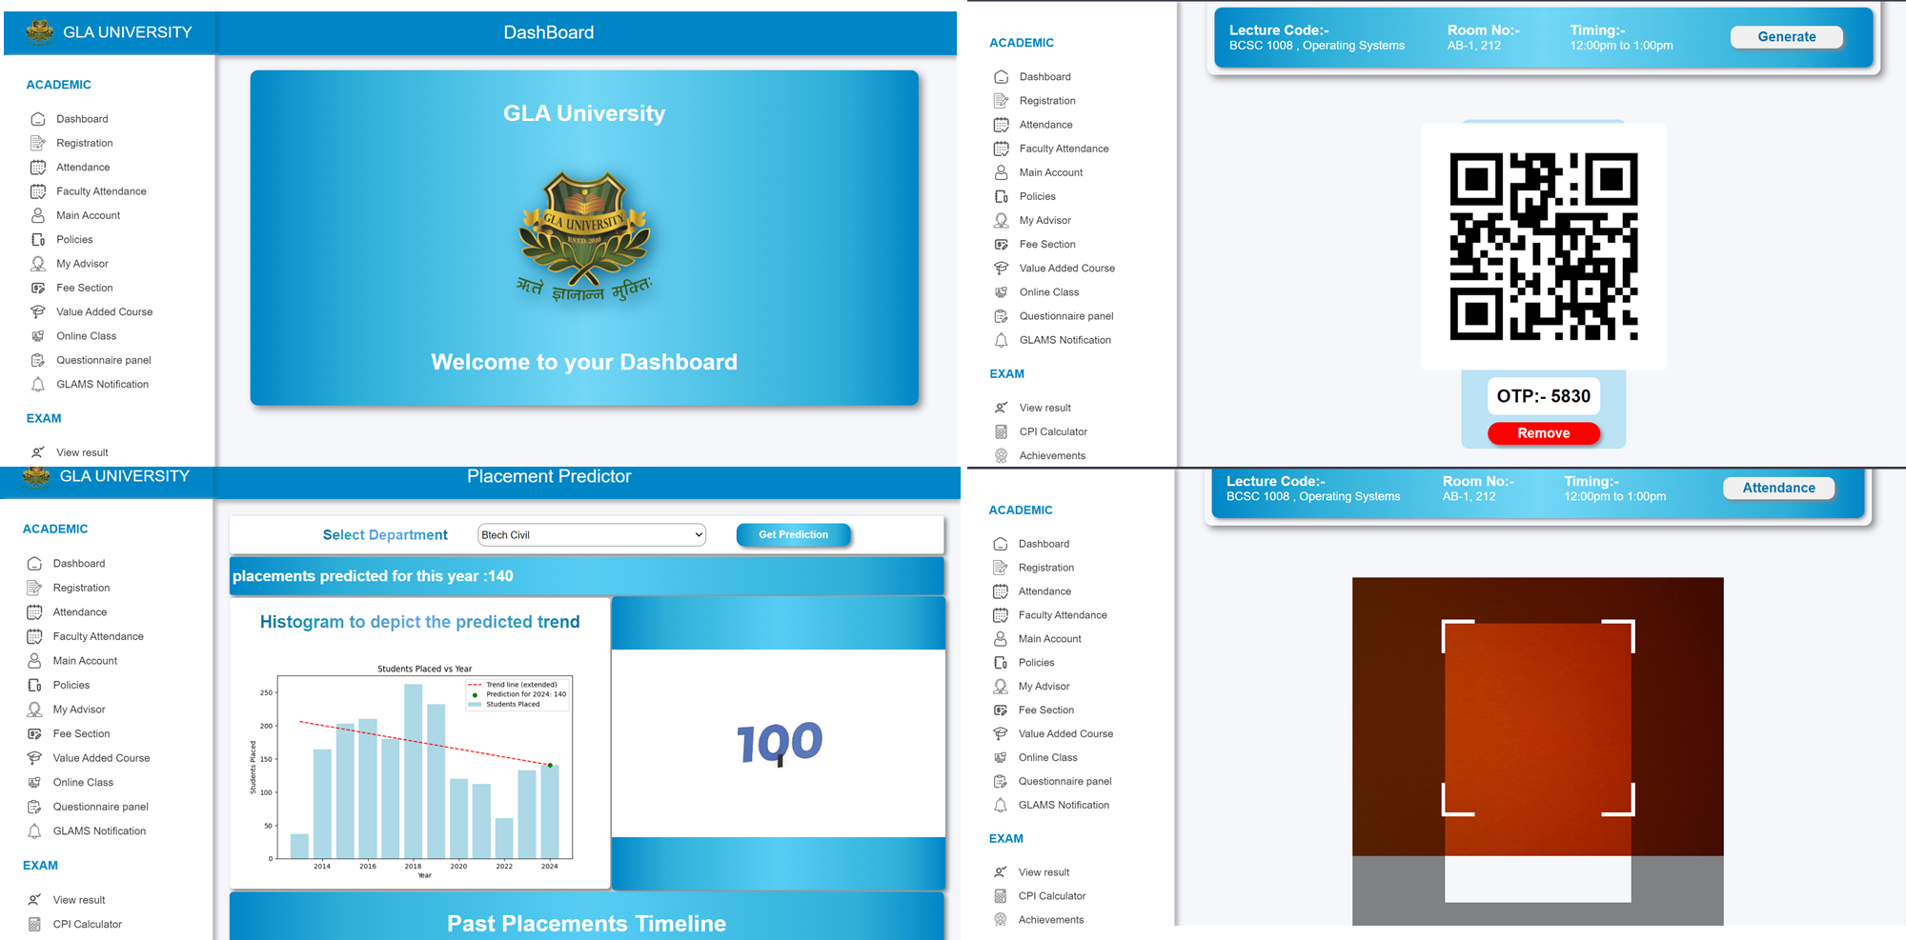
SNAPSHOTS

Slide 6
Future Plans
Continue working on optimizing the deployment procedures.
Address the current issue with serverless deployment.
Implement any additional features or improvements based on feedback.
Integrate the detention predictor so students can know detaining chances.
Set milestones for testing and refining the attendance management.
Prepare for potential scalability and integration challenges.

Slide 7
CONCLUSION
Project Achievements: Successful completion of development and designing phases.
Enhanced Capabilities: Predictors and Attendance marking using QR has significantly enhanced the process.
Current Focus: Addressing dataset handling issues to ensure accurate responses.
Future Goals: Refining features based on feedback and preparing for scalability.
Team Effort: Acknowledgment of the hard work and dedication of all team members.
Impact: The project has set a strong foundation for future enhancements and applications.

Slide 8


